Slide 1
CONSISTENT HASHING
Advanced Algorithms Project
PES1201701575 : Aishwarya Kumaraswamy
PES1201700227 : Madhav Mahesh Kashyap
PES1201802433 : Priyanka Kumari

Slide 2
Distributed hashing
In some situations, it may be necessary or desirable to split a hash table into several parts, hosted by different servers due to memory limitation
In such a scenario, the objects (and their keys) are distributed among several servers.
(DHT) is a decentralized storage system that provides lookup and storage schemes similar to a hash table, storing key-value pairs.
Each node in a DHT is responsible for keys along with the mapped values.
Any node can efficiently retrieve the value associated with a given key.
Properties:
Decentralised & Autonomous
Fault-Tolerant
Scalable

Slide 3
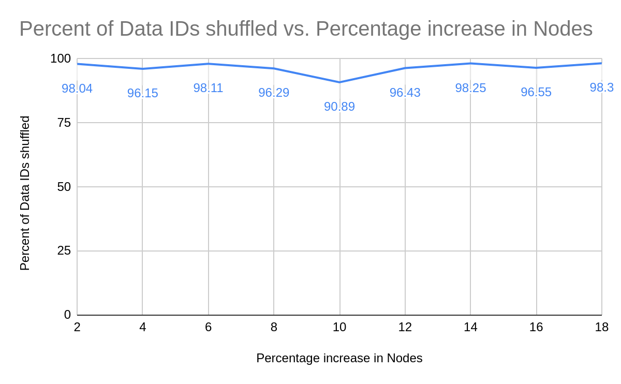
Problems with Naïve Modulo Hashing
Let’s suppose we change the number of nodes by adding/deleting nodes.
Since the keys are distributed depending on the number of nodes, and the number of nodes has changed; the hash value of the new nodes are completely different from the previous node hash values.
As we can see, almost 90-98 % of the data IDs change their nodes
This shifting of data IDs results in a huge performance hit in large scale distributed applications.

Slide 4

Consistent Hashing
It uses a method called “Collision Hashing“ which calculates the Hash function of each node independently of the Number of Nodes in the ring. This avoids repositioning
The Data IDs are mapped onto the next Node they find in Clockwise direction of the ring.
Whenever a Node is added, only the load balance of the 2 servers which the new server is added in between is affected.
Similarly, when a node is deleted, only the server which lies next in the clockwise direction will be affected.

Slide 5
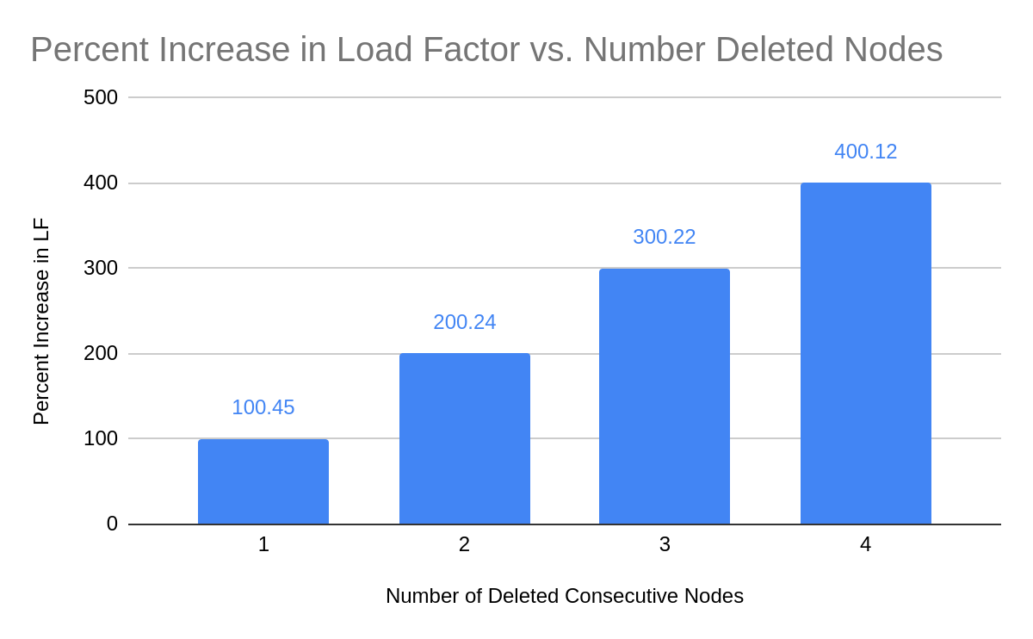
Problems with Naive Consistent Hashing
Although Average theoretical load of each node still remains: 1/N
The load balances of individual nodes can be skewed very heavily above/below the expected average load balance.
Removing continuous nodes in the ring makes transfers the load of the previous ‘n’ servers onto the next server clockwise. This makes the next server’s load increase disproportionately compared to the other nodes.

Slide 6

Consistent Hashing with Virtual Nodes
Multiple virtual nodes are mapped to the same node. (For eg. A1, A2.. An all map to node A)
If we delete A, we actually delete all the virtual nodes from A1 to An. The extra load of deleting A is shared by N other virtual nodes.
Therefore, there is insignificant skewing of data IDs in case of addition/deletion of nodes.

Slide 7
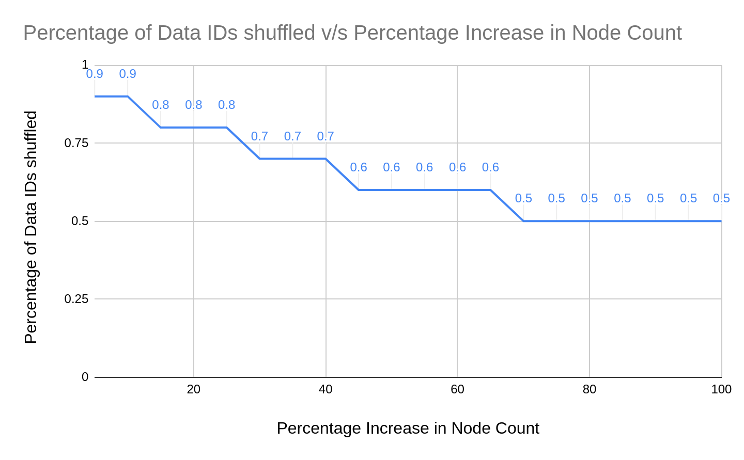
Consistent Hashing with Virtual Nodes
The percentage of reshuffling is only in the range of ( 0.5% to 0.9% ) whereas, in the case of Distributed hashing, it was in the ( 90% to 98% ) range. When adding/deleting nodes, Consistent hashing with Virtual nodes perform 100 times faster than Distributed Hashing.

Slide 8
Consistent Hashing with BST
We use Binary Search Tree to store the hash values of the nodes.
BST have the following advantages:
We can get all keys in sorted order by just doing Inorder Traversal of BST. This is not a natural operation in Hash Tables and requires extra efforts.
Doing order statistics, finding closest lower and greater elements, doing range queries are easy to do with BSTs. Like sorting, these operations are not a natural operation with Hash Tables.
With Self-Balancing BSTs, all operations are guaranteed to work in O(Logn) time. But with Hashing, Θ(1) is the average time and some particular operations may be costly, especially when table resizing happens.

Slide 9
Operations on a BST
Adding a Node : O(log N) + Time complexity of hash algorithm
Deleting a Node : O(log N) + Time complexity of hash algorithm
Searching for a Node : O(log N) + Time complexity of hash algorithm

Slide 10
Comparison
BST version of consistent hashing works better than the hash table version.
The time complexity of the hash table version is O(N), where N is the number of nodes.
The time complexity of the BST is O(log N) where, N is the number of nodes.

